Slide 1

Accident predicting algorithm for road safety
Team No. 12
Sally, Petar, Sasha, Mihai, Jonas

Slide 2
Table of contents
Introduction
Problem Statement
Data Description
Methodology
Project Timeline
Week 4
Week 5
Week 6
Week 7
Approach
Involved steps
Reasoning
Risk
Legal
Data Sets
Features
Data Cleaning
Overview
Context and Background
Relevance and Importance
Project Objectives
Significance of Machine Learning Techniques
Purpose and Objectives
Overview and key objectives
Significance

Slide 3
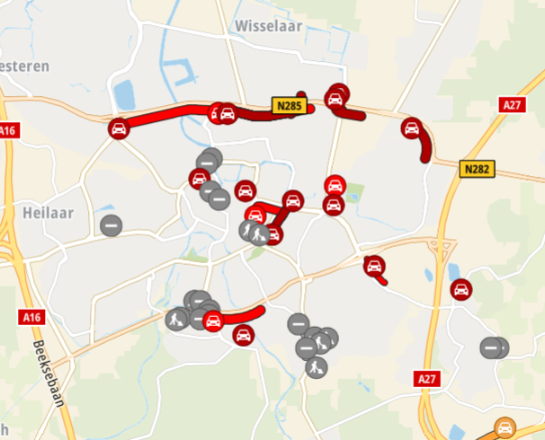
Introduction
Project Overview:
Aim: Enhance road safety and navigation experiences by developing a Google Maps extension.
Objective: Predict risk levels of roads (low, medium, high) using historical data for real-time risk assessments.
Statistics:
WHO: 1.2 million die yearly in road traffic accidents worldwide.
Netherlands: 8300 serious injuries, 745 deaths in 2022 (20% increase from 2021).
Key Objectives:
Develop ML model for accurate risk prediction.
Integrate model into Google Maps extension for visual cues.
Improve decision-making for drivers, reducing accident likelihood.
Significance of Machine Learning
Predictive Accuracy: Identifies patterns for accurate predictions.
Dynamic Updates: Learns from new data for relevance.
Scalability: Processes vast data for diverse regions and conditions.
Notes:
Content:
- Introduction (Dean, 5 min)
- Cognition/Data Management (Bram, 5 min)
- Computer Vision (Irene, 5/10 min)
- Robotics (Dean, 5/10 min)

Slide 4


Problem Statement
Overview:
The frequency and severity of road accidents are significant concerns.
Impactful for municipal authorities, insurance companies, and logistics firms.
Accidents result in economic losses, injuries, and fatalities.
Predicting and preventing accidents is complex due to multiple contributing factors.
Context and Background:
Road Safety Statistics:
Thousands of road accidents occur annually.
Causes significant economic costs and human impact.
Accident
Contributing Factors:
Weather conditions, time of day, road type, traffic conditions.
Understanding these factors is essential for predictive models.
Relevance and Importance:
Economic Impact:
Road accidents lead to high medical expenses, vehicle repairs, and lost productivity.
Predictive models can help reduce these costs.
Safety Improvements:
Enhancing road safety through predictive modelling can save lives and reduce injuries.
Contributes to public well-being.
Data-Driven Decisions:
Machine learning provides data-driven insights.
Guides infrastructure improvements and policy decisions.

Slide 5

Problem Statement
Project Objectives:
Develop a Predictive Model:
Utilize machine learning to predict road accidents.
Factors include weather, time, and road conditions.
Integrate with Existing Systems:
Add functionality to platforms like Google Maps.
Provide real-time accident predictions and alerts.
Stakeholder Benefits:
Offer insights to municipal authorities, insurance companies, and logistics firms.
Enhance road safety measures and reduce accident-related costs.
Significance of Machine Learning Techniques:
Complex Data Analysis:
Machine learning can analyse complex datasets with multiple variables.
Provides accurate predictions that traditional methods might miss.
Continuous Improvement:
Models continuously improve predictions by learning from new data.
Conclusion:
Our project aims to develop a robust solution to enhance road safety.
Reduces accident-related costs and provides valuable insights for stakeholders.

Slide 6
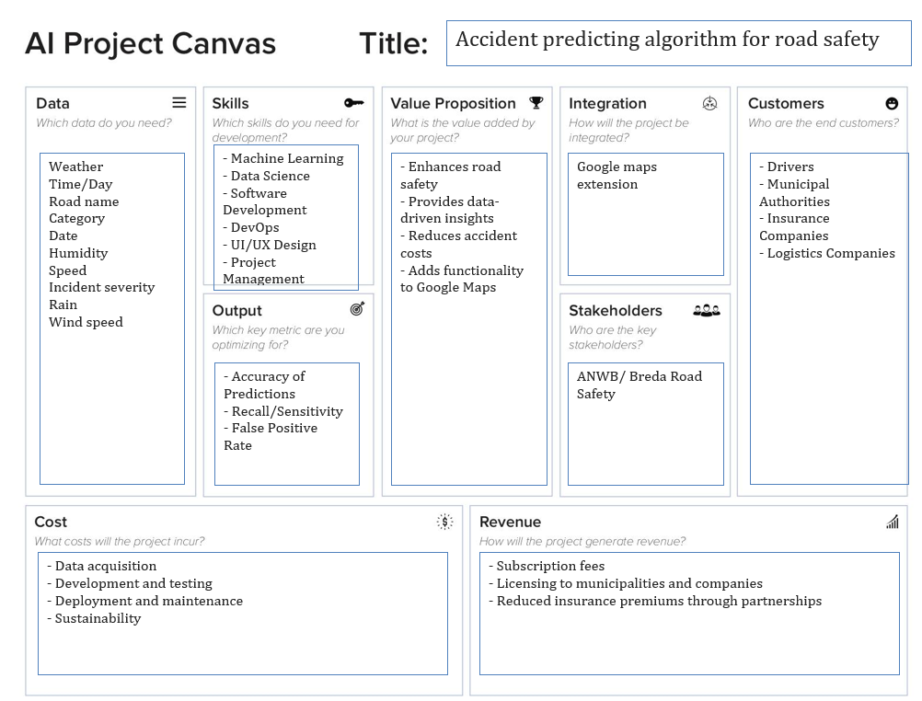
Problem Statement
AI canvas:

Slide 7

Data Description
ANWB - Safe Driving Dataset:
Features incident specifics like time, location, speed, and severity.
Key for understanding driving behaviors and incident patterns.
KNMI - Meteorological Data:
Includes environmental variables such as temperature, wind speed, and precipitation.
Essential for analyzing weather impacts on road safety.

Slide 8
Data Description
Pre-processing Steps
Data Cleaning:
Address missing values and outliers, especially in speed and meteorological data.
Data Transformation:
Standardize date formats and encode categorical variables for analytical consistency.
Data Integration:
Merge traffic and weather data based on timestamps and locations to examine combined effects.
Feature Engineering:
Develop new metrics like average weather conditions during incidents and extract time-based features to uncover underlying patterns.

Slide 9
Methodology
Approach
To tackle the problem of developing a road safety AI google extension, we plan to follow a structured approach comprising several key steps: data collection, pre-processing, model selection, training, evaluation, and deployment.

Slide 10
Methodology
Involved Steps
Data Collection
The Data Collection step includes finding sources of data, establishing what types of data are needed and ensuring a large and diverse dataset.
Data Pre-processing
The Data Pre-processing step includes cleaning and normalizing the data. It can also include labeling and augmenting data, if needed.
Model Selection
The Model Selection step includes finding the best model to train and test the data on.
Training
The Training step includes training the model on the pre-processed training data.
Evaluation
The Evaluation step includes grading the performance of the model on the pre-processed test data.
Deployment
The Deployment step includes deploying the model, evaluating its performance in real time and collecting feedback for making the model better.

Slide 11
Methodology
Tools and Techniques
SQL
SQL (Structured Query Language) is a language for managing and manipulating relational databases. Techniques include SELECT queries, JOINs, subqueries, and indexing.
Python
Python is a versatile, high-level programming language for web development, data analysis, AI, and automation. Techniques include loops, functions and libraries.
Python libraries: psycopg2, sqlalchemy, pandas, matplotlib
psycopg2: A PostgreSQL adapter for Python, enabling database connection, querying, and transaction management.
SQLAlchemy: A Python ORM (Object-Relational Mapping) for database interaction, providing high-level abstractions and direct SQL execution.
pandas: A data manipulation and analysis library, offering DataFrame objects for handling structured data.
matplotlib: A plotting library for Python, used to create static, animated, and interactive visualizations.

Slide 12
Methodology
Machine Learning Model(s)
There are many models that can be used for this problem. One of those models is the random trees model. The random trees model, often referred to as a random forest, is an ensemble learning method for classification and regression. It builds multiple decision trees and merges their results for improved accuracy and robustness. Random trees is used for its ability to improve predictive accuracy, handle large datasets with higher dimensionality, reduce overfitting, and provide robust predictions through ensemble learning.

Slide 13
Methodology
Risk Level and Legal Obligations
The AI extension that we are developing falls under the high-risk category. It does so because it intervenes with road authorities and misconduct of the application can recommend to the user actions that lead to what is considered by law enforcement unlawful action. The legal obligations that need to be followed can be found in the GDPR documentation and the EU AI Act. We will address the legal obligations by shaping our AI model to meet the requirements put forward by these regulations.

Slide 14
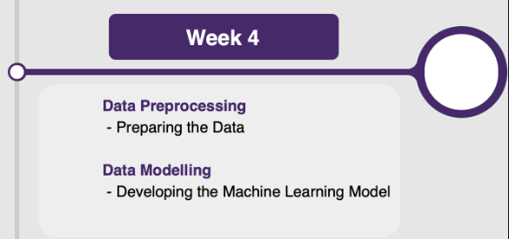
Project Timeline (Week 4)
Tasks:
Data Preprocessing:
Clean and organize raw datasets.
Handle missing values, normalisation, and standardisation.
Address outliers and inconsistencies.
Prepare the data for initial analysis.
Initial Modelling:
Develop baseline predictive/descriptive models using preprocessed data.
Begin exploratory data analysis (EDA) to understand data patterns and distributions.
Document findings and potential challenges for the team to address.
Team Contributions:
: Lead data cleaning and normalisation efforts.
: Handle standardisation and outlier detection.
: Conduct exploratory data analysis (EDA) and document insights.
: Assist with data preprocessing and initial model development.
: Coordinate tasks and ensure timely completion of the preprocessing phase.
Notes:
Data Preprocessing:
Our first task is to clean and organize the raw datasets. This involves removing any irrelevant or duplicate data.
Next, we handle missing values, which means filling in or removing any gaps in our data.
We also need to normalize and standardize the data to ensure consistency.
Additionally, we must address any outliers and inconsistencies that could skew our analysis.
Finally, we prepare the data for initial analysis, ensuring it’s ready for the next phase.
Initial Modelling:
We start by developing baseline predictive and descriptive models using the preprocessed data. This helps us set a benchmark for our analysis.
Then, we perform exploratory data analysis, or EDA, to understand data patterns and distributions.
It’s important to document our findings and any potential challenges so the team can address them efficiently.
Team Contributions:
One team member will lead the data cleaning and normalization efforts, ensuring our data is accurate and consistent.
Another will handle the standardization process and detect any outliers that need to be addressed.
A third member will conduct the exploratory data analysis and document insights, which will guide our modelling efforts.
We’ll also have support with data preprocessing and initial model development to keep the workflow smooth.
Finally, one member will coordinate tasks and ensure the timely completion of the preprocessing phase, making sure we stay on track.

Slide 15

Project Timeline (Week 5)
Tasks:
Developing the Machine Learning Model:
Select appropriate algorithms for predictive modelling (e.g., regression, classification).
Train models using the preprocessed data.
Optimize model parameters to improve accuracy.
Begin evaluating the models based on initial performance metrics.
Team Contributions:
: Develop and optimize predictive models.
: Evaluate model performance and perform hyperparameter tuning.
: Document performance metrics and compare different models.
: Assist with model training and optimization.
: Oversee the modelling process and ensure comprehensive documentation.
Notes:
Developing the Machine Learning Model:
Our primary task is to select appropriate algorithms for predictive modelling. This includes methods like regression and classification.
Once we have our algorithms, we train the models using the preprocessed data.
We then optimize the model parameters to enhance accuracy and performance.
Finally, we begin evaluating the models based on initial performance metrics to understand how well they are performing.
Team Contributions:
One team member will focus on developing and optimizing the predictive models to ensure they are accurate and reliable.
Another will evaluate the model performance and perform hyperparameter tuning to refine the models further.
A third member will document the performance metrics and compare different models to identify the best performing one.
We’ll also have support in assisting with model training and optimization, ensuring a smooth workflow.
Finally, one member will oversee the entire modelling process and ensure comprehensive documentation, keeping everything organized and on track.

Slide 16

Project Timeline (Week 6)
Tasks:
Evaluating the Model:
Assess model performance using predefined metrics (e.g., accuracy, precision, recall, F1-score).
Validate models against a holdout dataset or through cross-validation.
Document evaluation results and insights for further improvements.
Fine-Tuning the Hyperparameters:
Perform hyperparameter tuning to enhance model performance.
Implement iterative improvements based on evaluation feedback.
Refine and test models to achieve optimal results.
Team Contributions:
: Lead the evaluation process and document findings.
: Perform hyperparameter tuning and validate models.
: Document changes and their impact on performance.
: Support the iteration process with additional data analysis.
: Ensure all iterations are well-documented and communicate progress to the team.
Notes:
Slide Notes
Tasks:
Evaluating the Model:
Our first task is to assess the model performance using predefined metrics such as accuracy, precision, recall, and F1-score.
Next, we validate the models against a holdout dataset or through cross-validation to ensure their reliability.
We will document the evaluation results and insights to identify areas for further improvements.
Fine-Tuning the Hyperparameters:
We perform hyperparameter tuning to enhance the model's performance.
Implement iterative improvements based on the feedback from our evaluation.
We refine and test the models continuously to achieve optimal results.
Team Contributions:
One team member will lead the evaluation process and thoroughly document the findings.
Another will perform hyperparameter tuning and validate the models.
A third member will document any changes made and their impact on the model’s performance.
We’ll also have support for additional data analysis during the iteration process.
Finally, one member will ensure that all iterations are well-documented and communicate progress to the team, maintaining transparency and coordination.

Slide 17
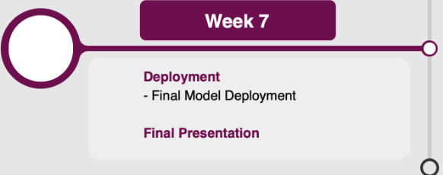
Project Timeline (Week 7)
Tasks:
Final Model Deployment:
Finalize the best-performing model for deployment.
Prepare deployment scripts and ensure compatibility with production environments.
Conduct final testing to validate model performance in real-world scenarios.
Final Presentation:
Compile comprehensive documentation of the model development process.
Prepare a deployment guide and user manual.
Create presentation materials summarizing the project, methodology, and results.
Present the final results and insights to stakeholders.
Team Contributions:
: Finalize deployment scripts and ensure model readiness.
: Conduct final testing and validation.
: Compile and organize documentation.
: Prepare deployment guide and user manual.
: Facilitate the handoff meeting and coordinate with the deployment team.
Notes:
Final Model Deployment:
First, we will finalize the best-performing model for deployment, ensuring it's the most accurate and reliable.
Next, we prepare deployment scripts and ensure compatibility with production environments.
Finally, we conduct thorough testing to validate the model's performance in real-world scenarios, ensuring it meets our expectations.
Final Presentation:
We will compile comprehensive documentation of the entire model development process, providing a clear record of our work.
Prepare a detailed deployment guide and user manual to facilitate smooth implementation and usage.
Create presentation materials that summarize the project, methodology, and results, highlighting key insights and findings.
Present the final results and insights to stakeholders, demonstrating the value and impact of our work.
Team Contributions:
One team member will finalize the deployment scripts and ensure the model is ready for deployment.
Another will conduct final testing and validation to confirm the model's real-world performance.
A third member will compile and organize all documentation for clarity and thoroughness.
We’ll also have support in preparing the deployment guide and user manual.
Finally, one member will facilitate the handoff meeting and coordinate with the deployment team, ensuring a seamless transition.

Slide 18
References
https://www.tomtom.com/traffic-index/breda-traffic/

Slide 19


Thank you for your attention!

